Slide 1
TRANSLATION STAGE CONTROL
Present by Nunnalin Auephattanaphong 630610745
Robotics and AI Engineering, CMU.

Slide 2
1
ABOUT INTERNSHIP PROJECT
2
Get to know instruments
TOPICS
Find Solution
3
Experiment
4
Conclusion
5

Slide 3
01
About Internship project
1

Slide 4
Translation stage control project is a mini project that part of EvWaCo project from NARIT.
Evanescent Wave Coronagraph or EvWaCo is project that study optical instruments for study about binary star system or exoplanetary system . EvWaCo aim to develop optical instruments for separate light from bright star to observe the companion star
The main idea of translation stage control project is control translation stage moving light source along horizontal axis to make the light source closest align to imaging system for get high quality image by using PID closed loop control .
2

Slide 5
Why we use PID Control ?
Stability and Responsiveness : The D term dampens oscillations, while the I term corrects steady-state errors, leading to a more stable system.
Improved Accuracy : The I term ensures the system output matches the desired setpoint more precisely.
Flexibility : PID provides three tunable parameters (Kp, Ki, Kd) to optimize performance for different systems and dynamic behaviors.
In summary, PID control offers balanced error management, enhancing stability, accuracy, and responsiveness over pure error control.
3

Slide 6
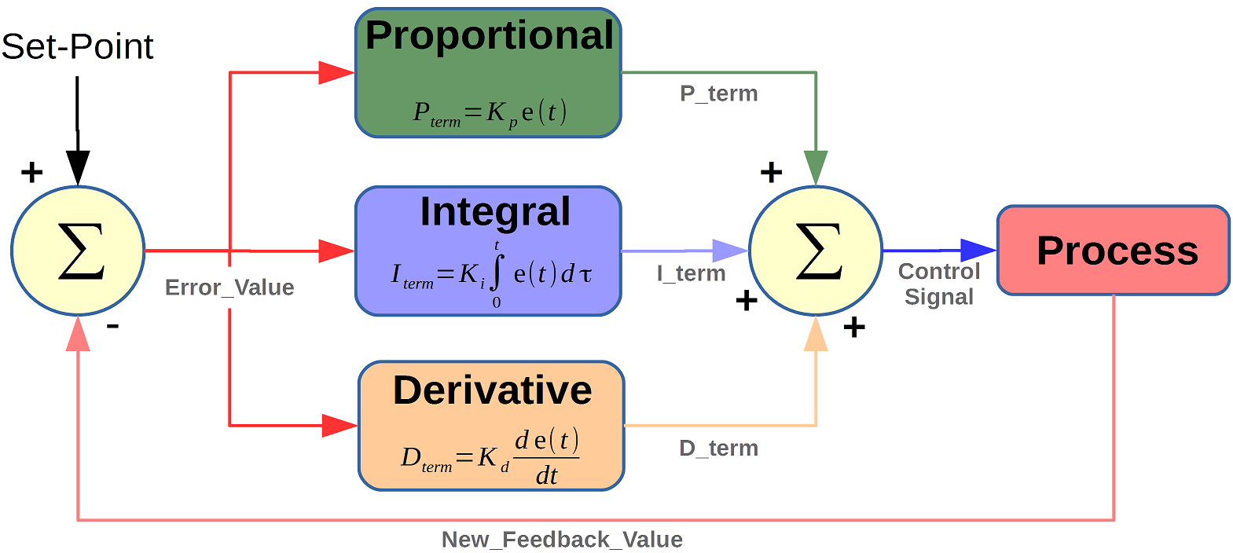
PID CONTROLLER
Stands for “Proportional, Integral, Derivative” .
It is closed-loop feedback control .
instrument used by control engineers to regulate temperature, flow, pressure, speed, and other process variables in industrial control systems.
https://microcontrollerslab.com/pid-controller-implementation-using-arduino/
4

Slide 7
PID CONTROLLER
P : Proportional
tuning -> correcting a target proportional to the difference
based on the current error ( setpoint - measured output of the system )
I : Integral
tuning -> cumulating the error result from the “P” action to increase the correction factor
Increase -> increases the contribution of the accumulated error over time to the control signal
D : Derivative
tuning -> minimize overshoot by slowing the correction factor
reduce the rate of change of the error
helps improve the stability and responsiveness of the control loop
5

Slide 8
02
Get to know instruments
6

Slide 9
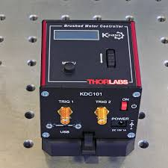
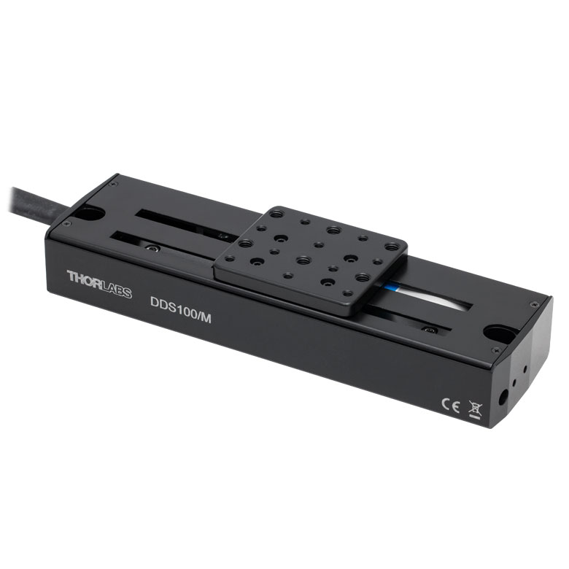
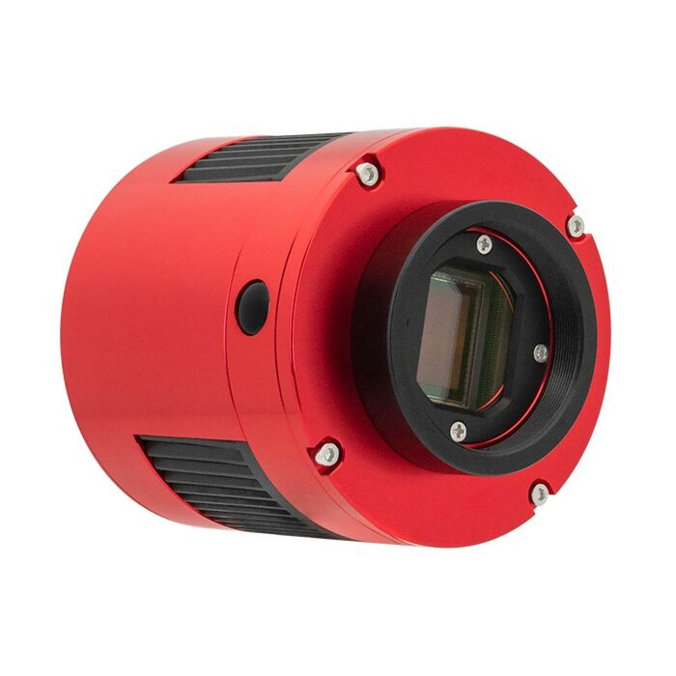
INSTRUMENTS
Mainly focus on
KDC101 -> Controller for control DDS100/M
DDS100/m -> One axis translation Stage
ASI1600mm PRO -> Camera for capture images
KDC101
DDS100/M
ASI1600mm PRO
chrome-extension://efaidnbmnnnibpcajpcglclefindmkaj/https://optomechs.com/pdf/manuals/KDC101/KDC101_ManualforKinesis.pdf
https://www.thorlabs.com/thorproduct.cfm?partnumber=DDS100/M
https://telescopes.net/zwo-asi1600mm-pro-monochrome-cmos-camera.html
Optical components
Light source
Mirrors
lens
7

Slide 10
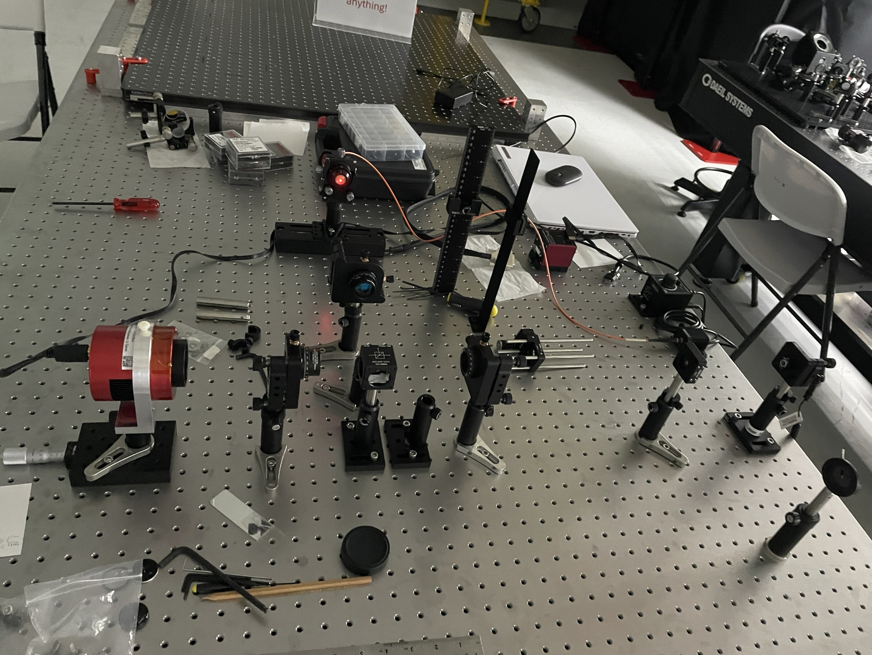
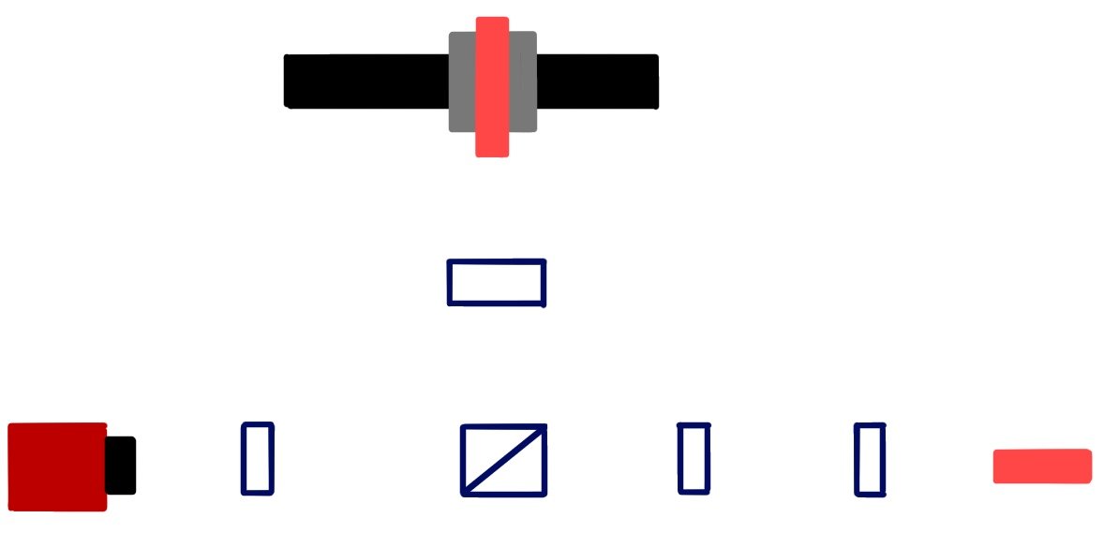
SETUP
Translation stage with light source
Lens
Lens
Mirror
Lens
Lens
ASI1600mm-PRO
Reference Light source
Schematic
8

Slide 11
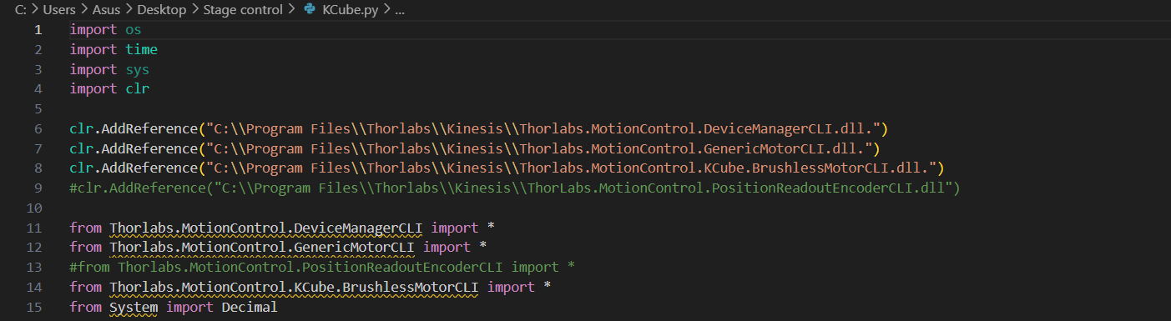
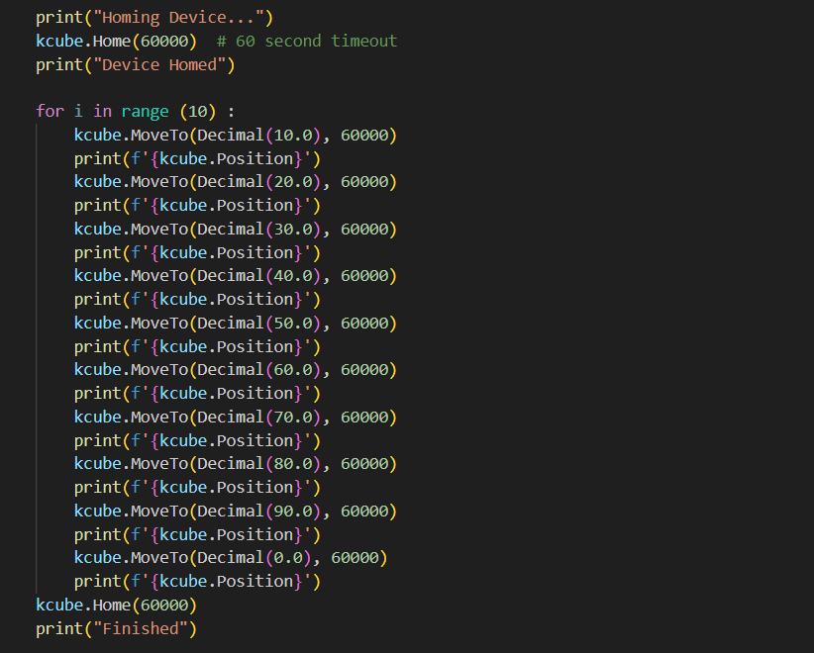
1. Find error of translation stage
Moving translation stage into steps for find error of stage .
Home position can’t change.
Home position is 0.0000 .
9

Slide 12
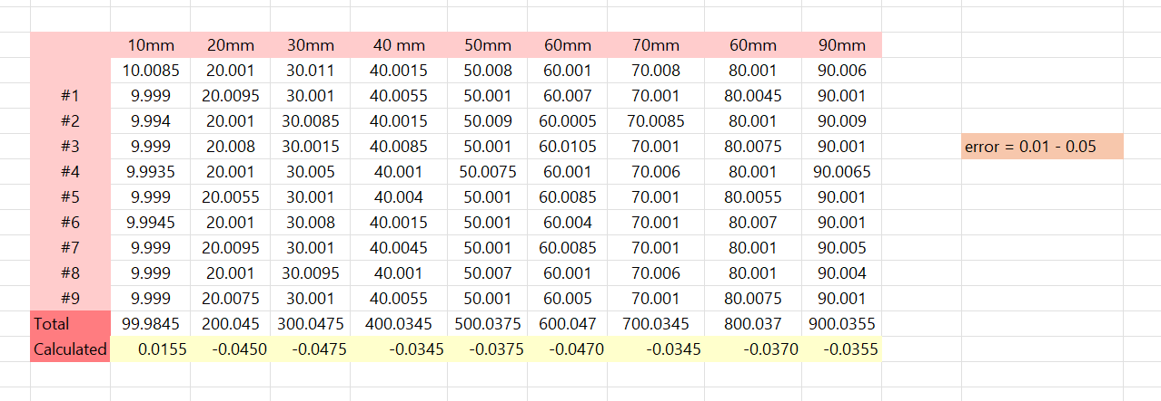
1. Find error of translation stage
Move translation stage from 10.00 mm to 90.00 mm and repeat for 10 times
then find range of error.
Range of Error of translation stage is 0.0100 – 0.0500 .
10

Slide 13
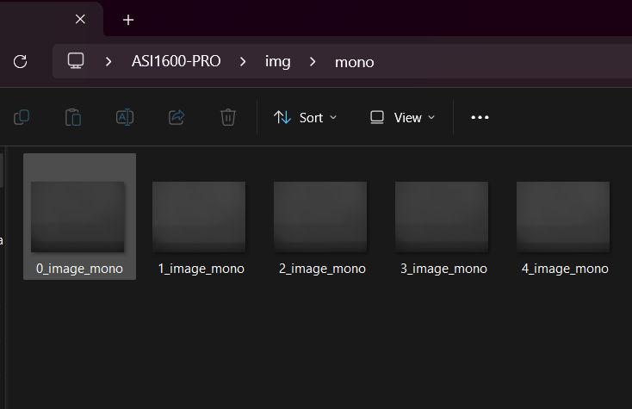
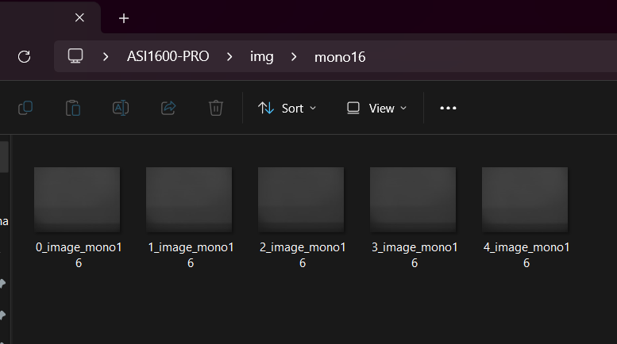
2. Capture image from camera
Try capture some image from ASI1600-PRO Camera and save images into .jpg for MONO8 and .tiff file. For MONO16
Focused parameters
Exposure time
Gain
FPS
11

Slide 14
03
Find Solution
12

Slide 15
START
Capture reference image
OVERVIEW MAP
Capture image
Focus on
Find error distance between 2 circles
No
PID CONTROL
Circles close to reference ?
Yes
FINISH
13

Slide 16
Mainly focus on
Find distance between 2 circles
Find solution of overlapped circles condition
14

Slide 17
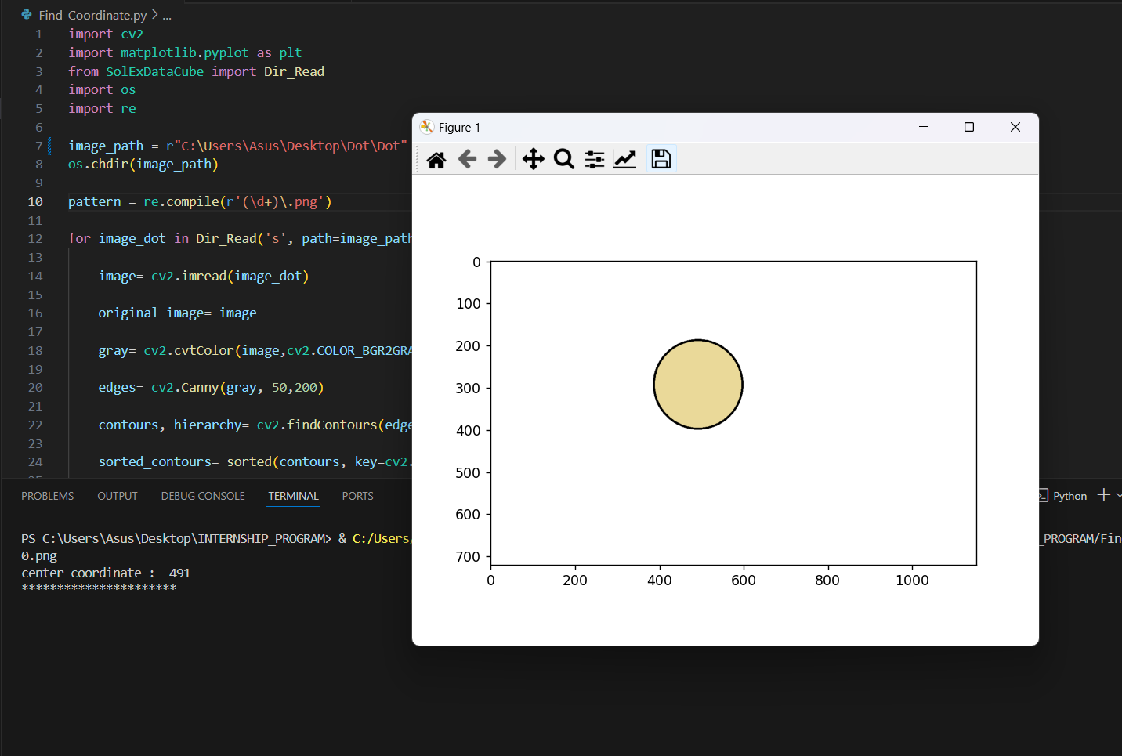
3. Find Solution
METHOD 1
Find center coordinates of circle by
Using OpenCV for find edge , contour area and coordinate of center point.
Use Matplotlib for plot circle.
15

Slide 18
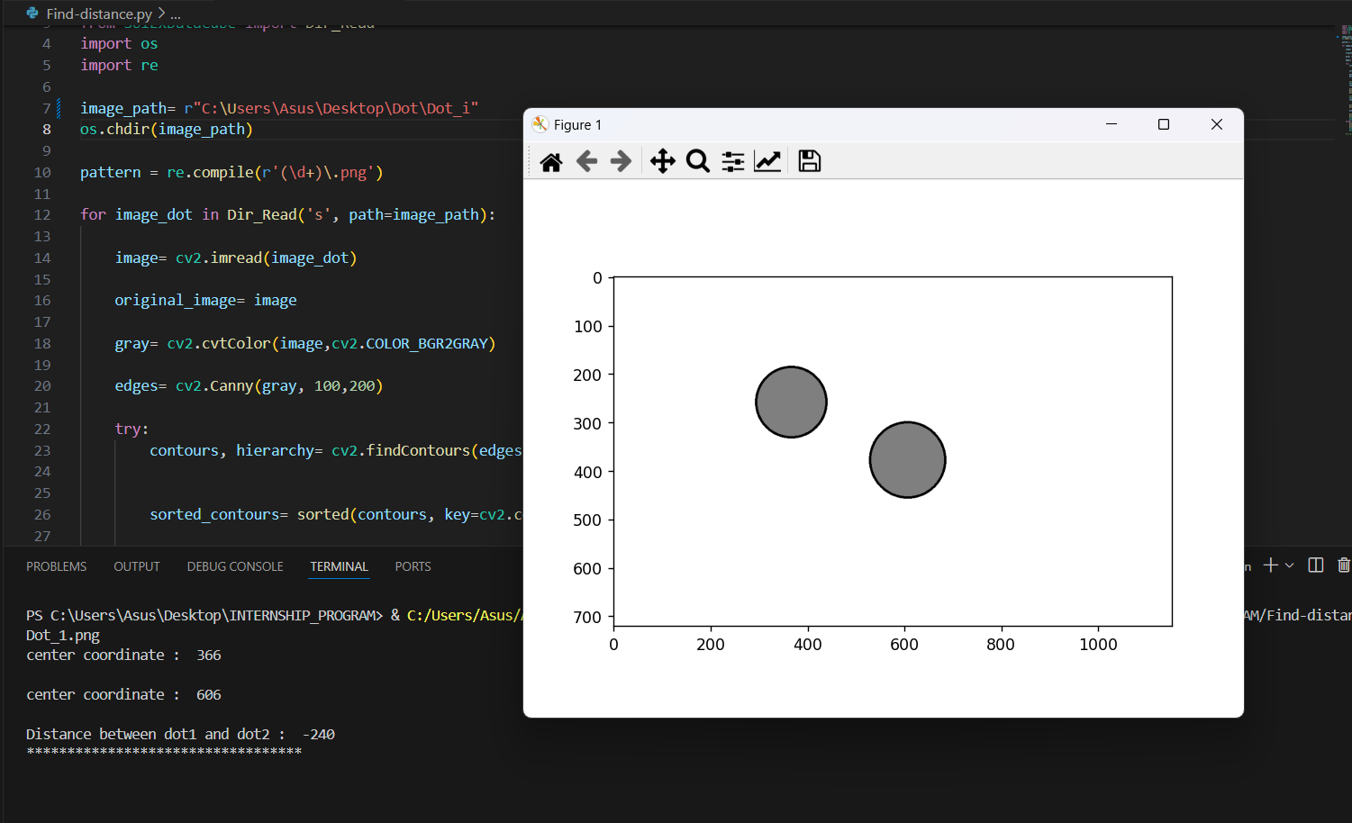
3. Find Solution
METHOD 1
Find distance between 2 circle by
1.Find coordinate of center of 2 circles
2.Subtrac coordinate of center of 2 circles
16

Slide 19
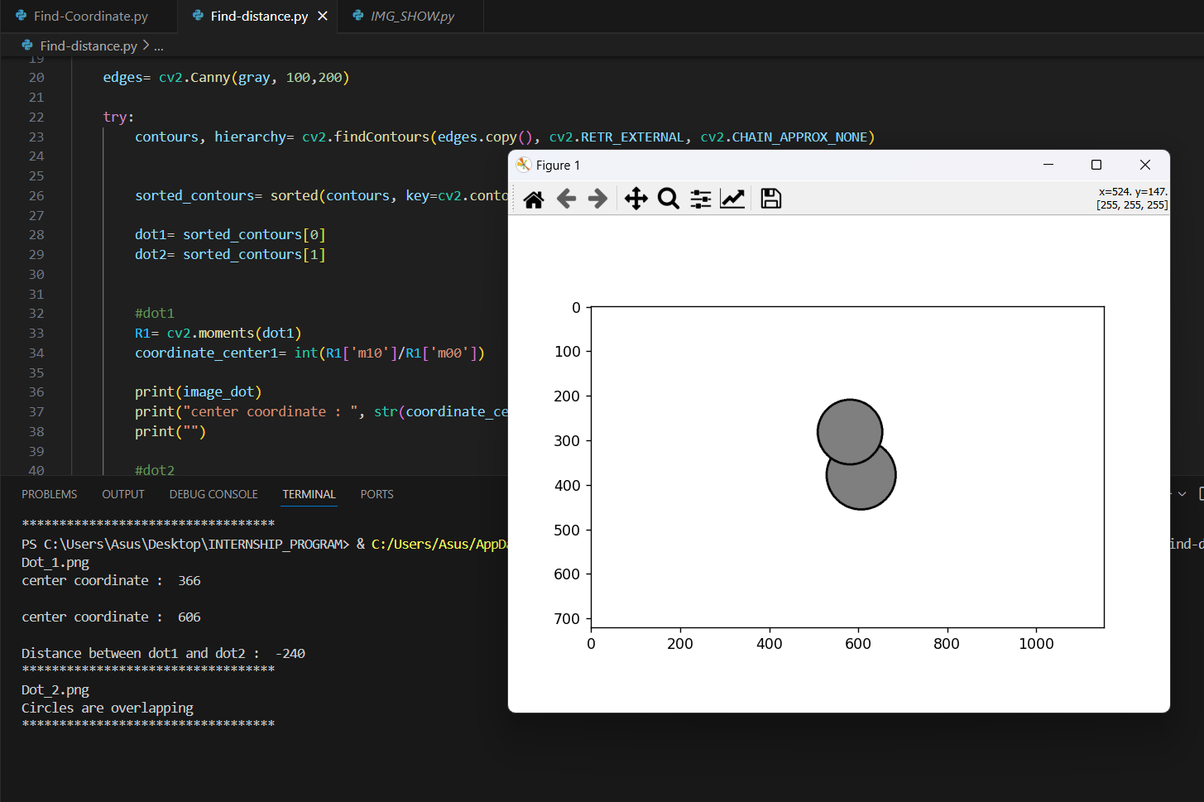
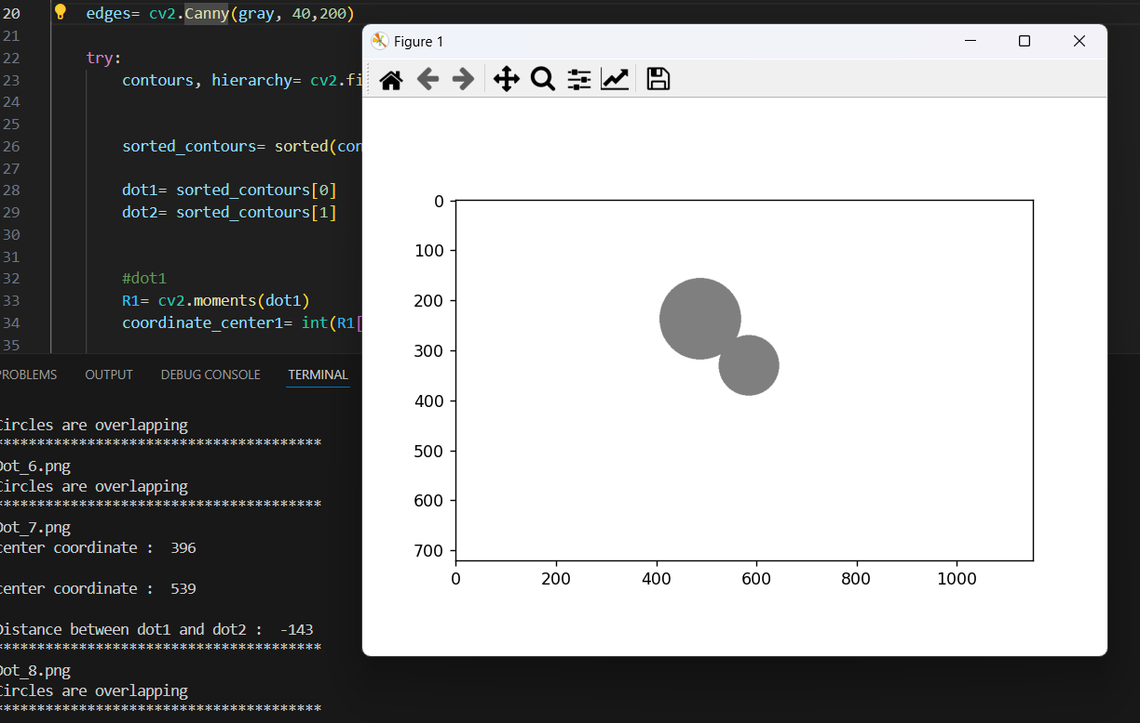
3. Find Solution
METHOD 1
Can’t use this condition with image that has 2 circles that are overlapping
17

Slide 20
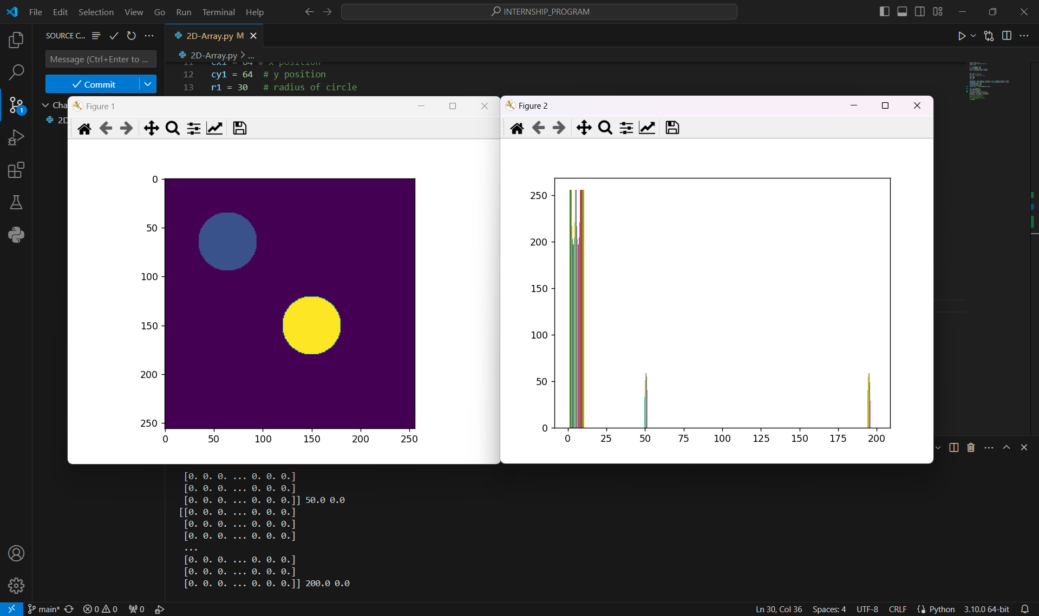
3. Find Solution
METHOD 2
Coding program for draw and plot circles from circle formula .
Initialize as 2D array .
Plot histogram for see intensity of circle
18

Slide 21
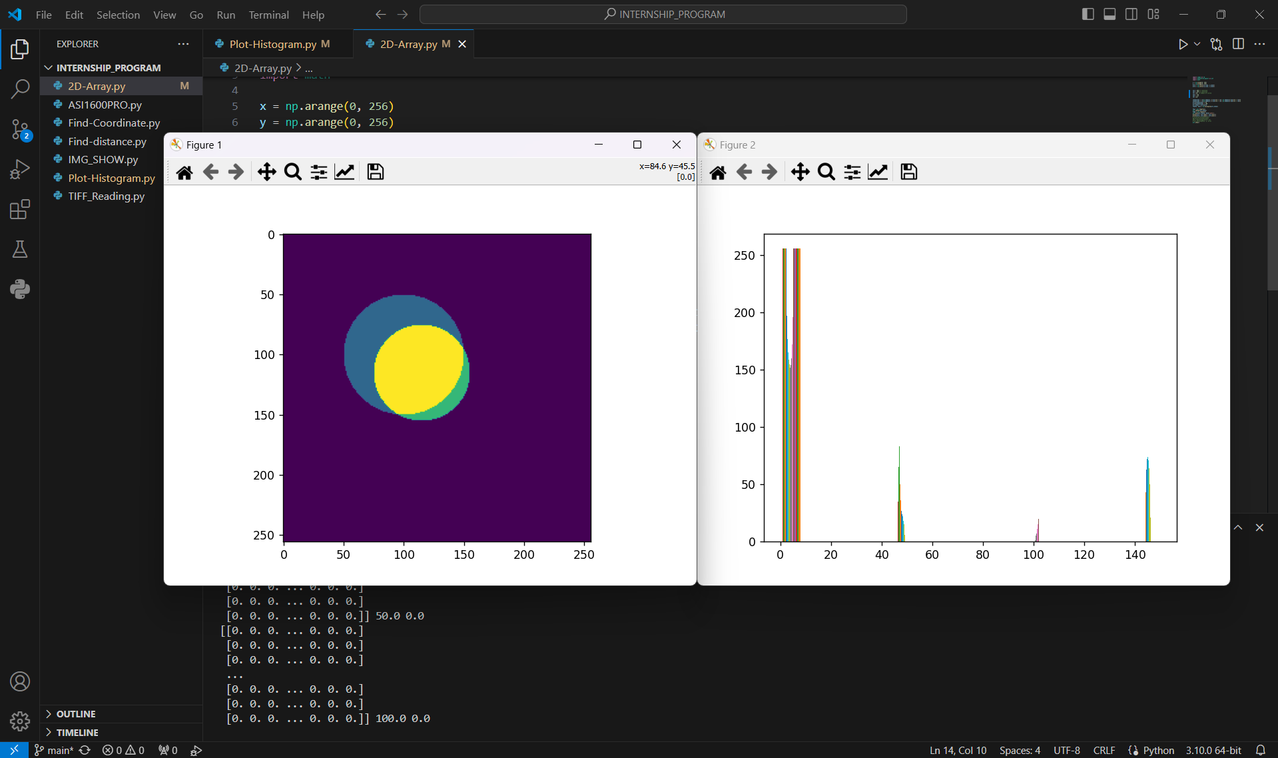
METHOD 2
3. Find Solution
This code works for overlapped circle condition .
19

Slide 22
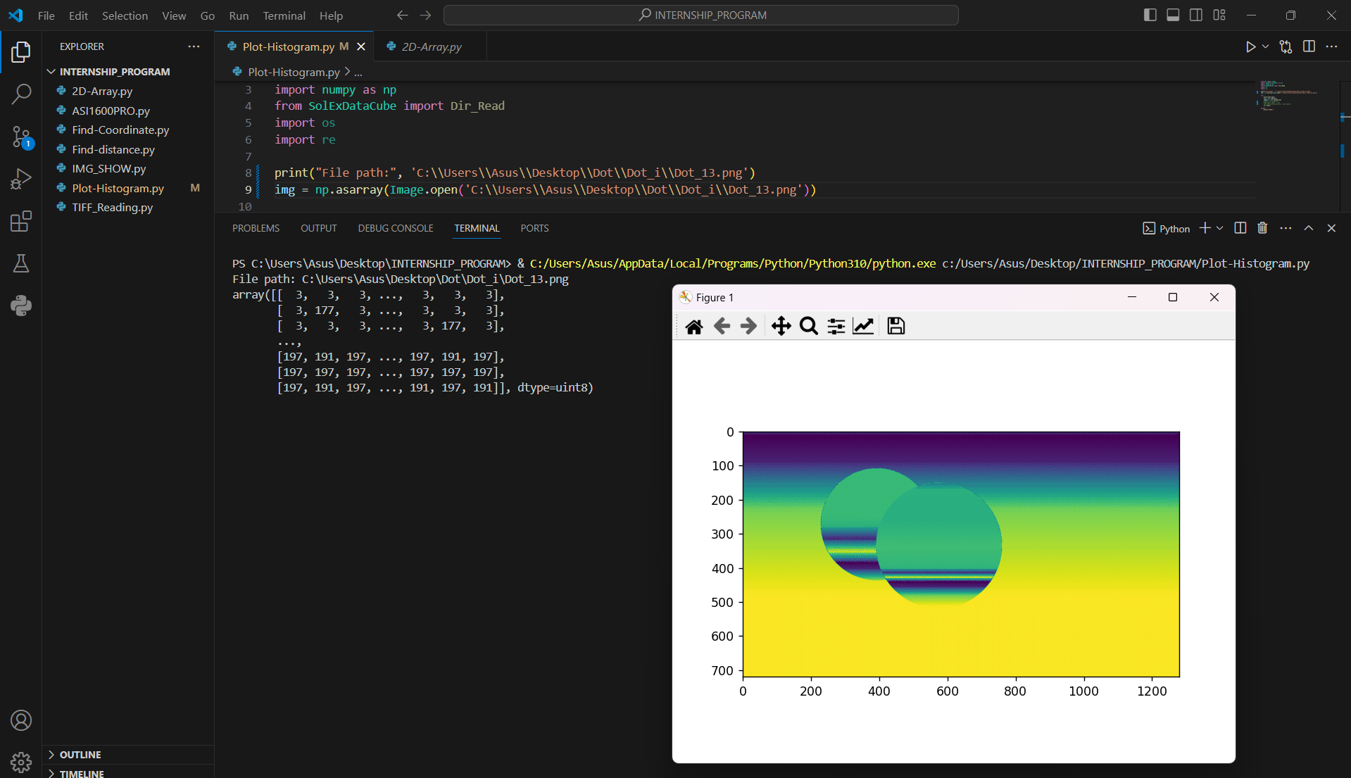
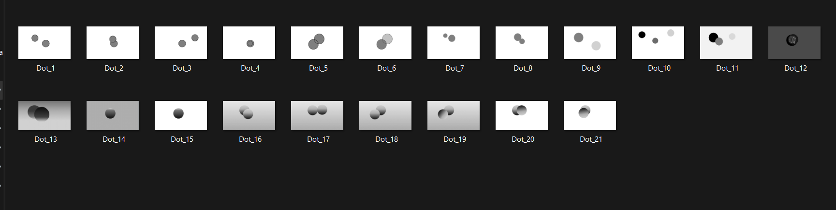
METHOD 2
3. Find Solution
Plot histogram from non-uniform image .
20

Slide 23
3. Find Solution
METHOD 2
Can’t return coordinate of center & distance between circles from histogram
21

Slide 24
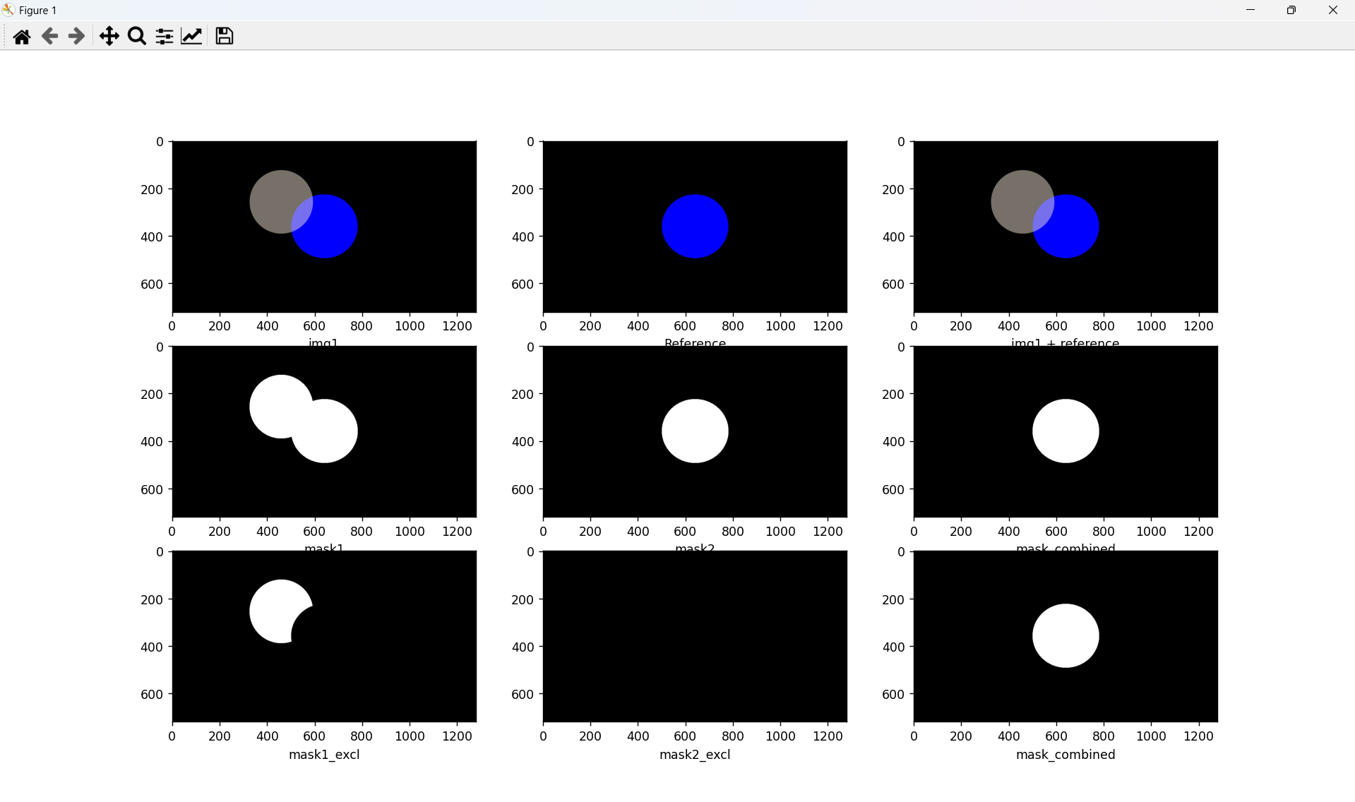
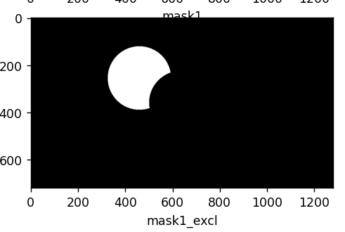
METHOD 3
3. Find Solution
AND
XOR
Main idea of this concept is
Use bitwise operation (AND , XOR) for find contour area that not overlapping. Then draw bounding box around the area then find height and width then calculate center of the area from height and width. Then find distance between 2 center point.
22

Slide 25
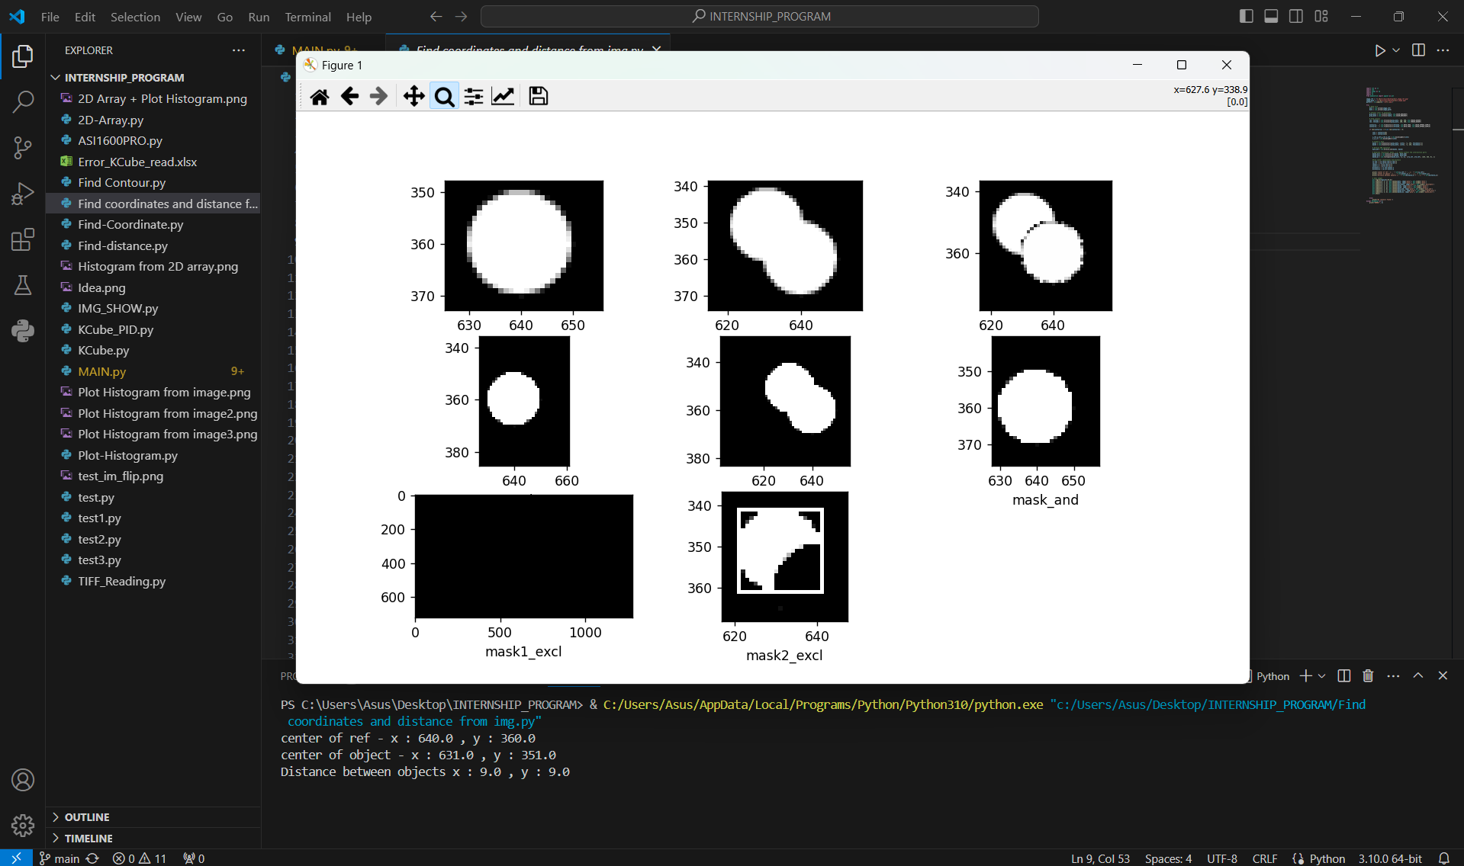
METHOD 3
3. Find Solution
23

Slide 26
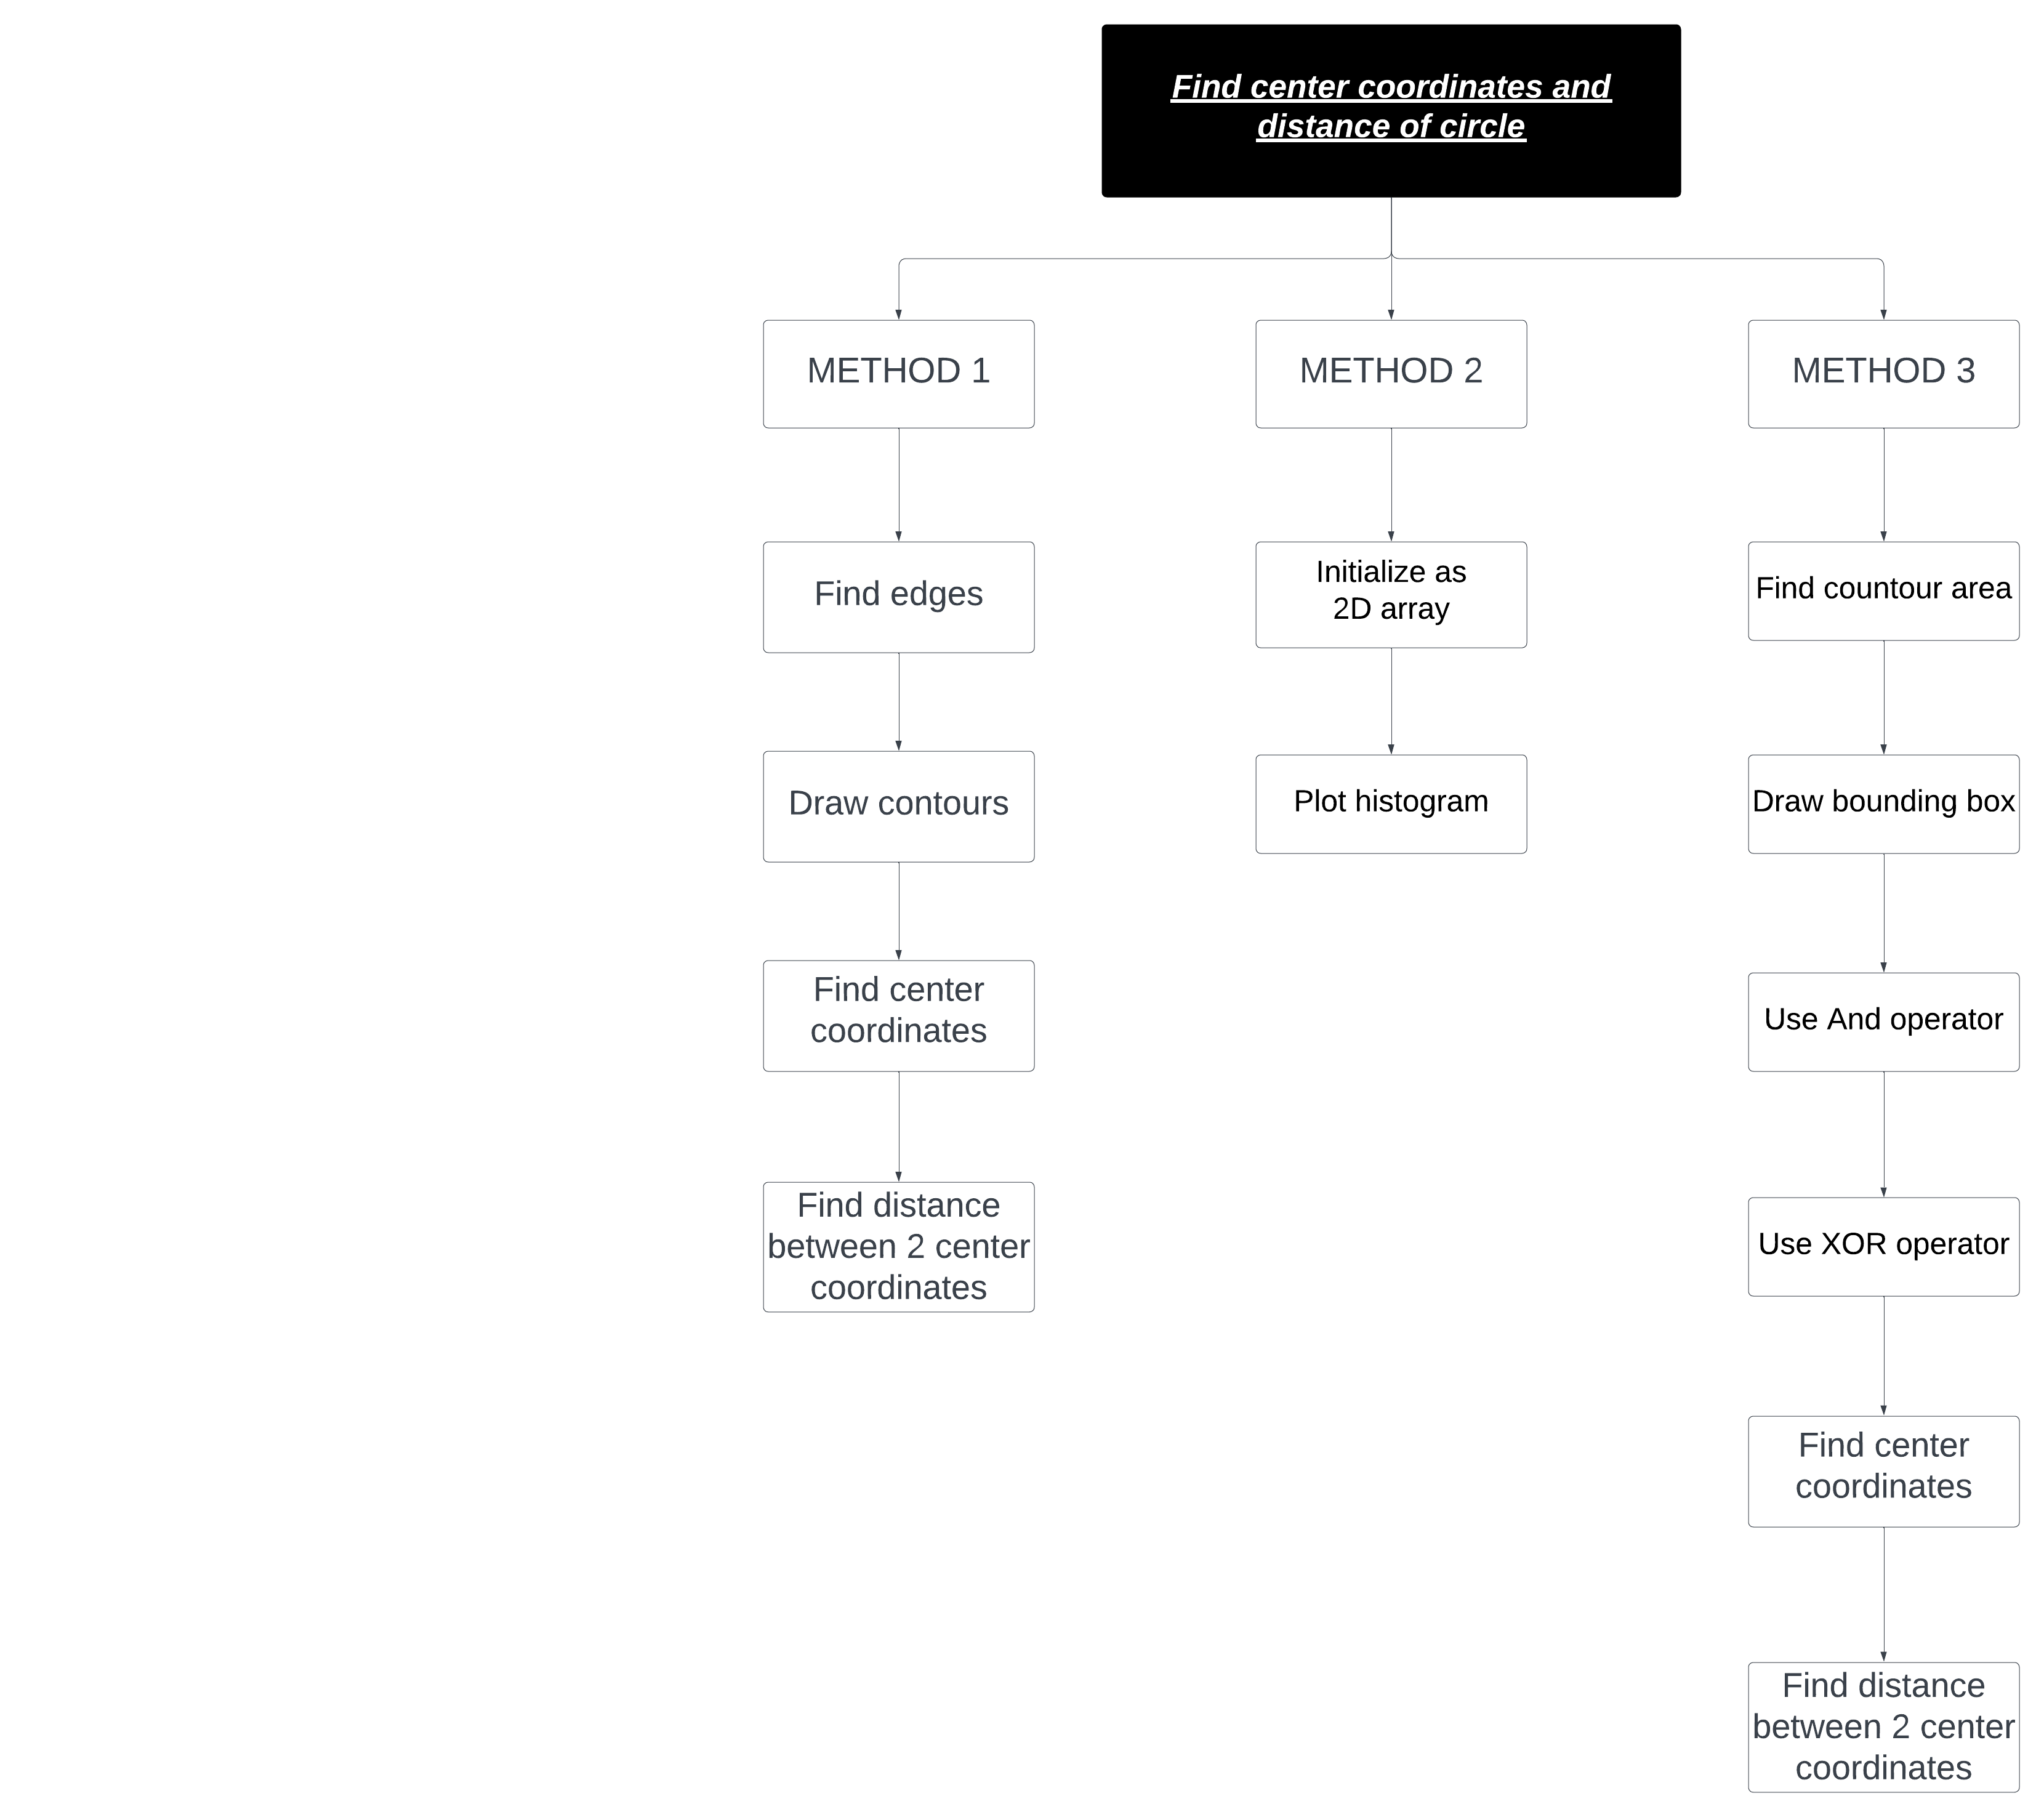
OVERVIEW MAP
24

Slide 27
METHODS | ADVANTAGES | DISADVANTAGES
METHOD 1 | Easy for operate | Can’t use this method with overlapped images
METHOD 2 | Can use this method with overlapped images | Can’t find distance between 2 images.
METHOD 3 | Can use this method with overlapped images | Take more time for operate
25

Slide 28
04
Experiments
26

Slide 29
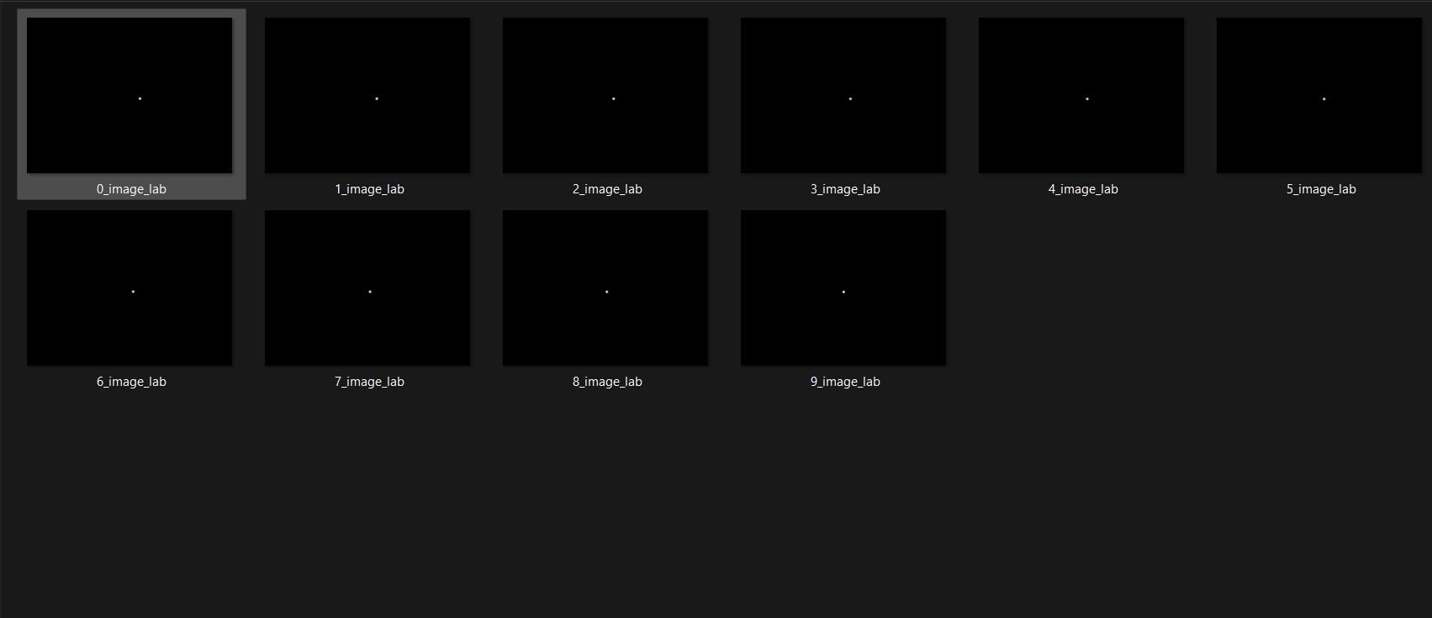
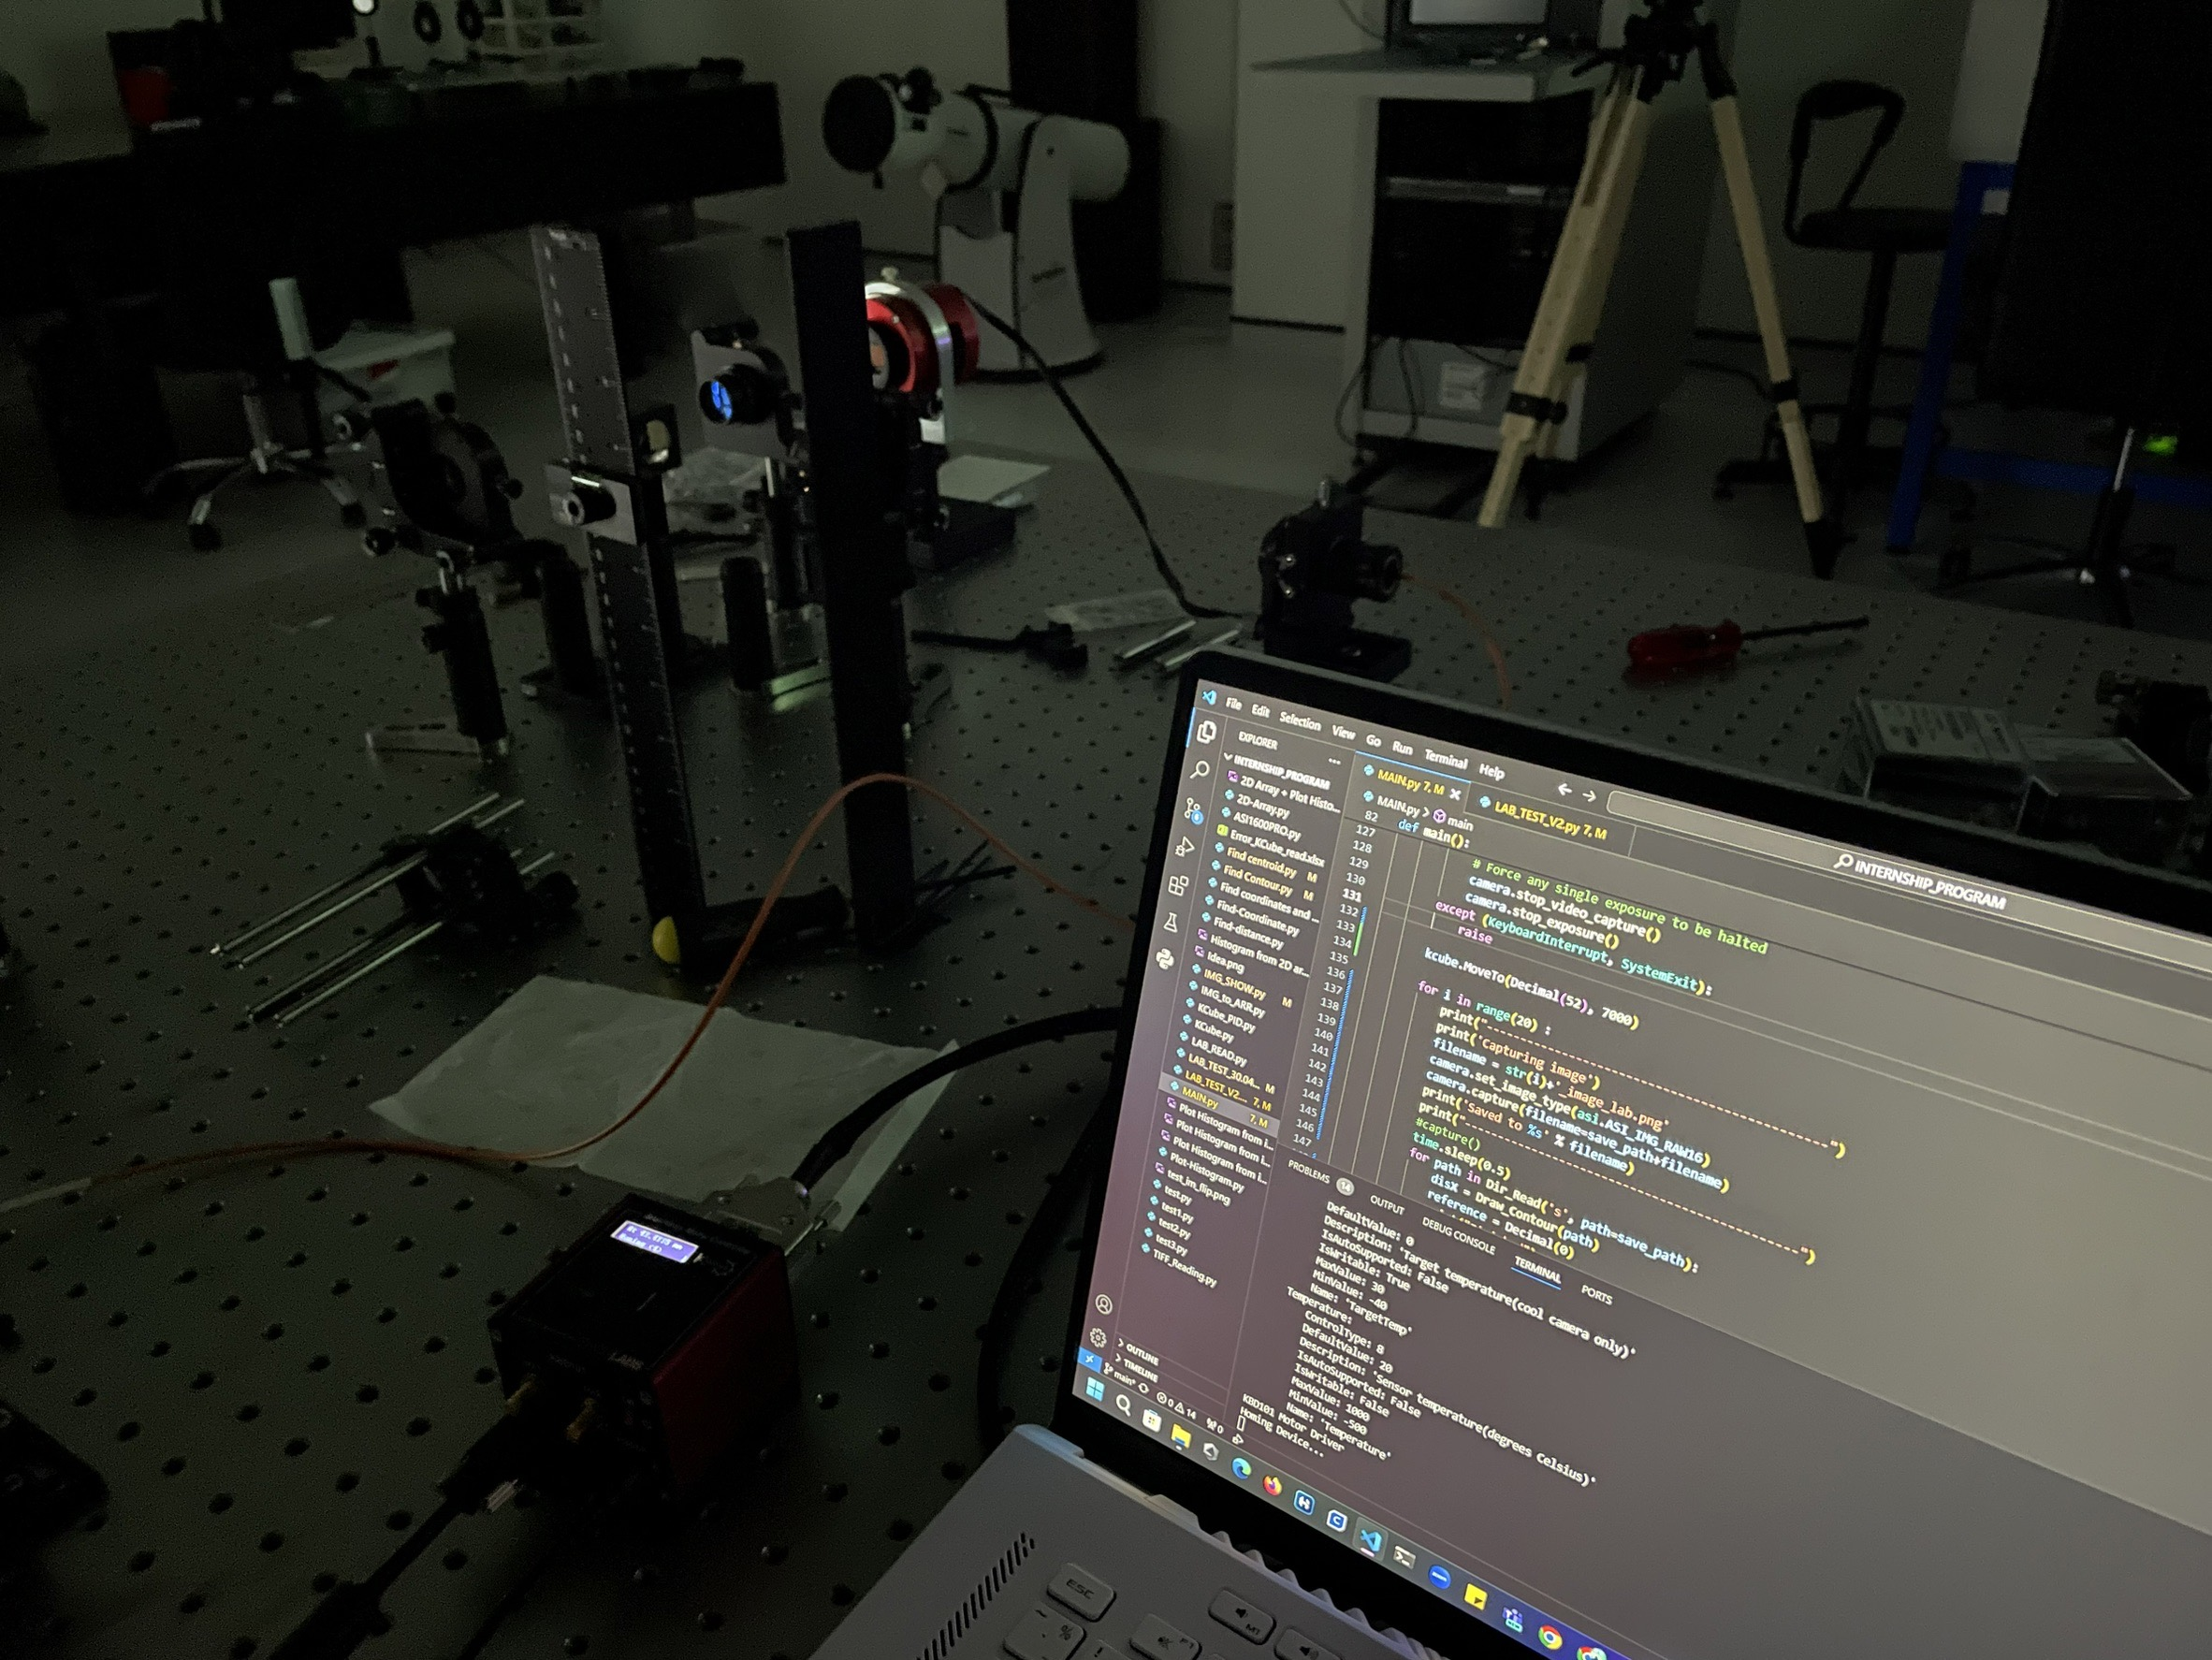
4. EXPERIMENT
Test code in lab for collect real data and find error of process of code when run in real situation.
27

Slide 30
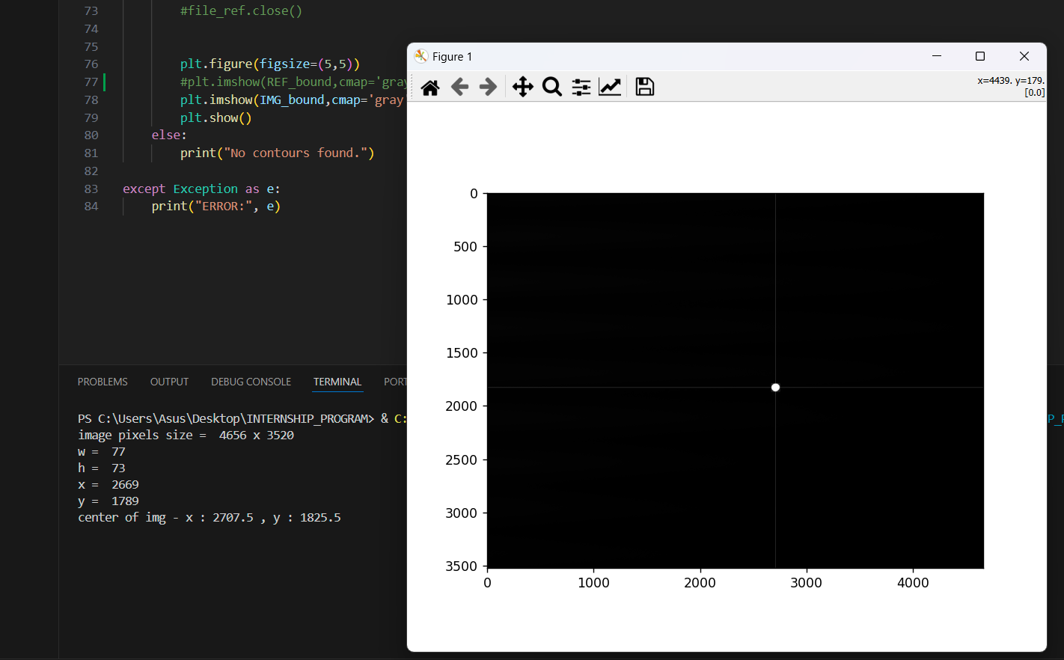
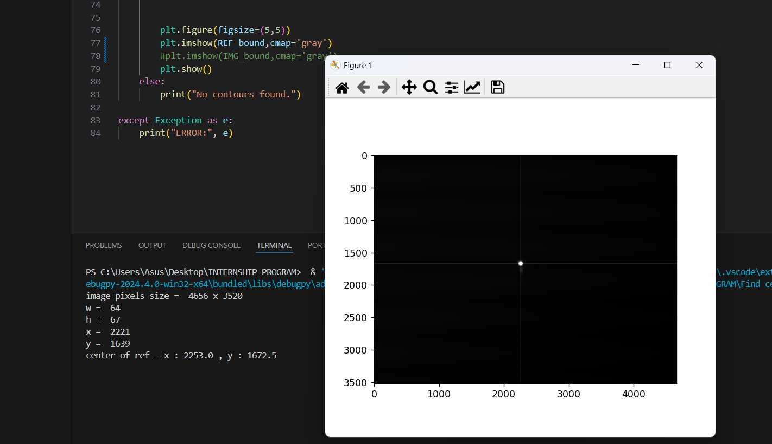
4. EXPERIMENT
Problem and solution 1
Have only one light source
so it can’t see 2 dot in one image at the same time.
Need to collect reference image before operate
Find centroid and position of dot both in reference image and current image.
Compare position of current image with reference image.
28

Slide 31
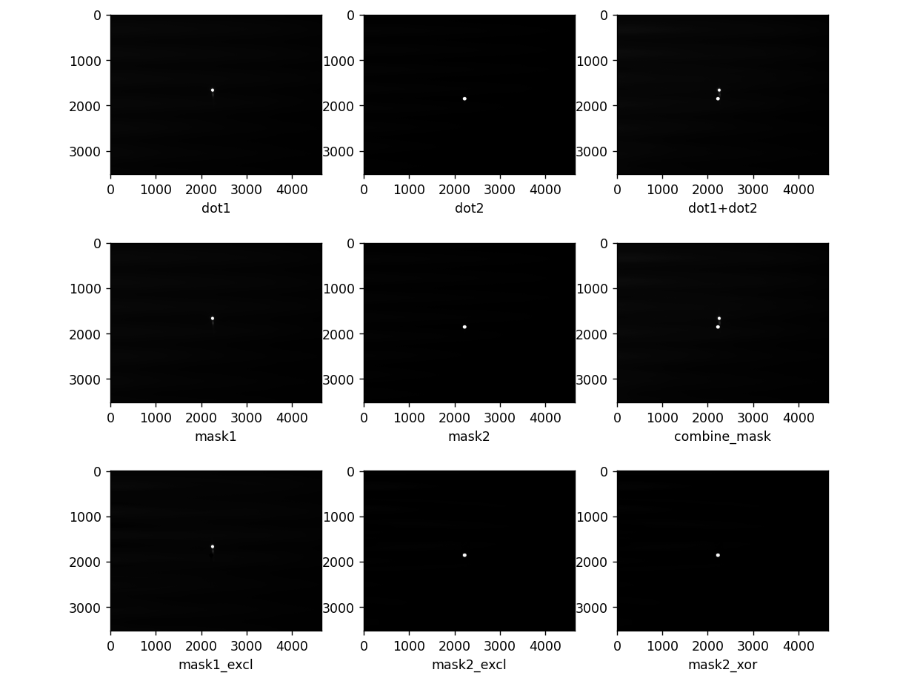
4. EXPERIMENT
29

Slide 32
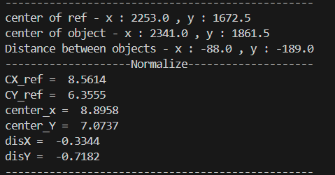
4. EXPERIMENT
Normalized data from pixel to mm.
30

Slide 33
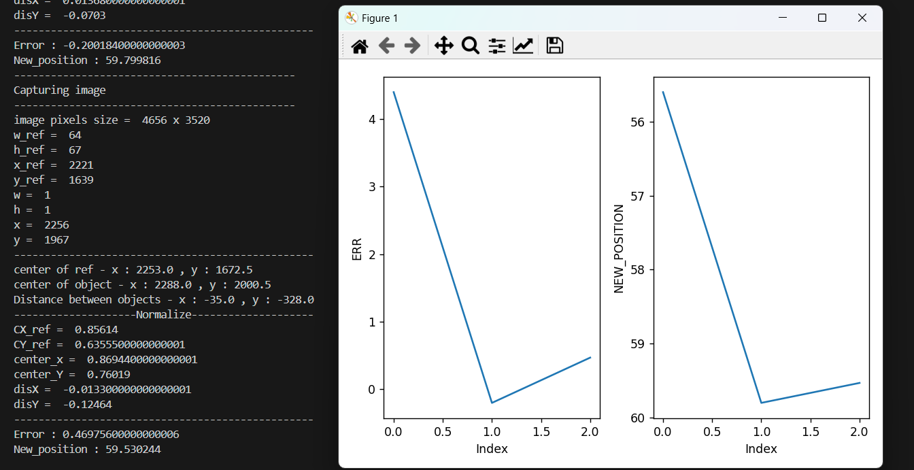
4. EXPERIMENT
Try read collected images and tuning pid then plot graph .
31

Slide 34
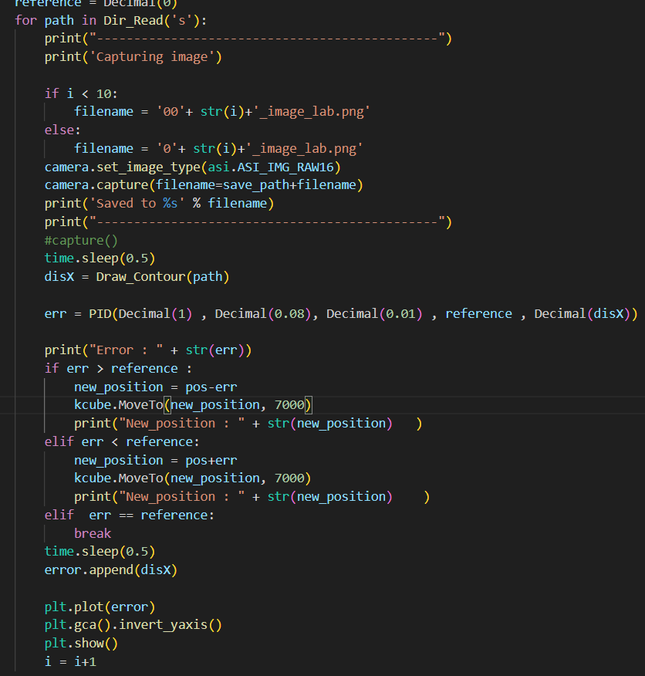
4. EXPERIMENT
Problem and solution 2
Program doesn’t read current images that had capture . It’s read and overwrite old images in directory instead .
Coding new program that has infinity loop and can read images from current images .
32

Slide 35
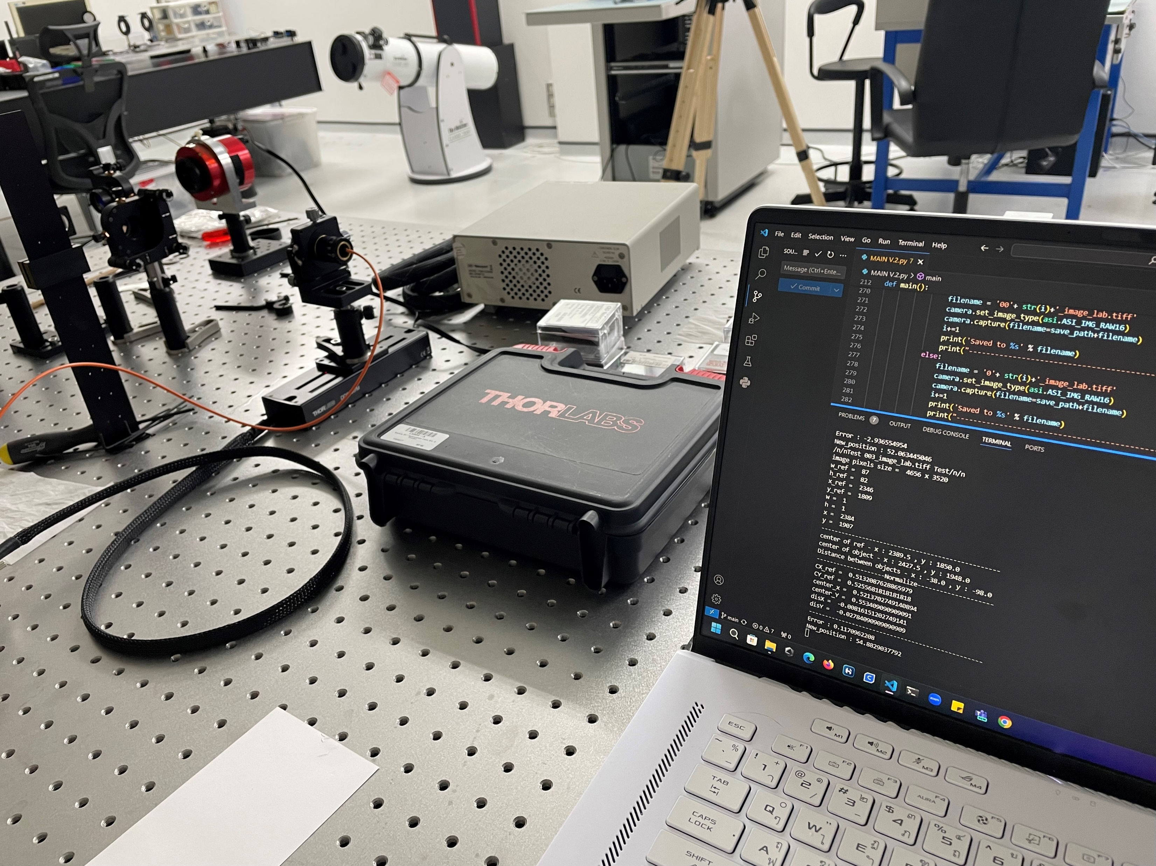
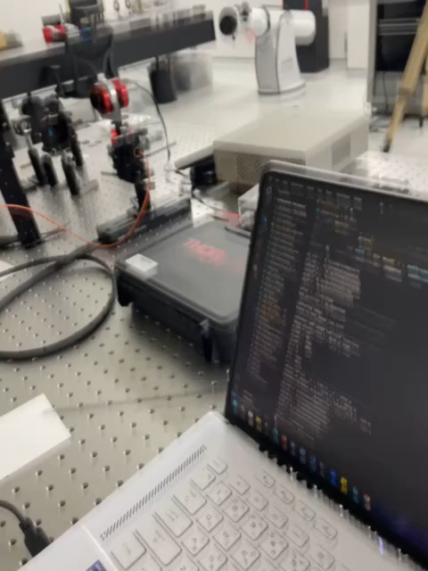
4. EXPERIMENT
Current : Trying tuning PID value .
33

Slide 36
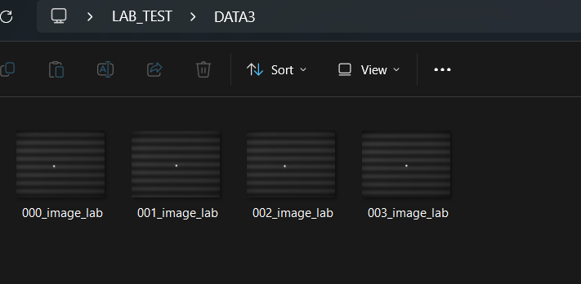
4. EXPERIMENT
RESULT
Successfully closed loop with PID control .
Understand the tuning PID parameter.
The range of acceptable position is 52.0 - 52.05
34

Slide 37
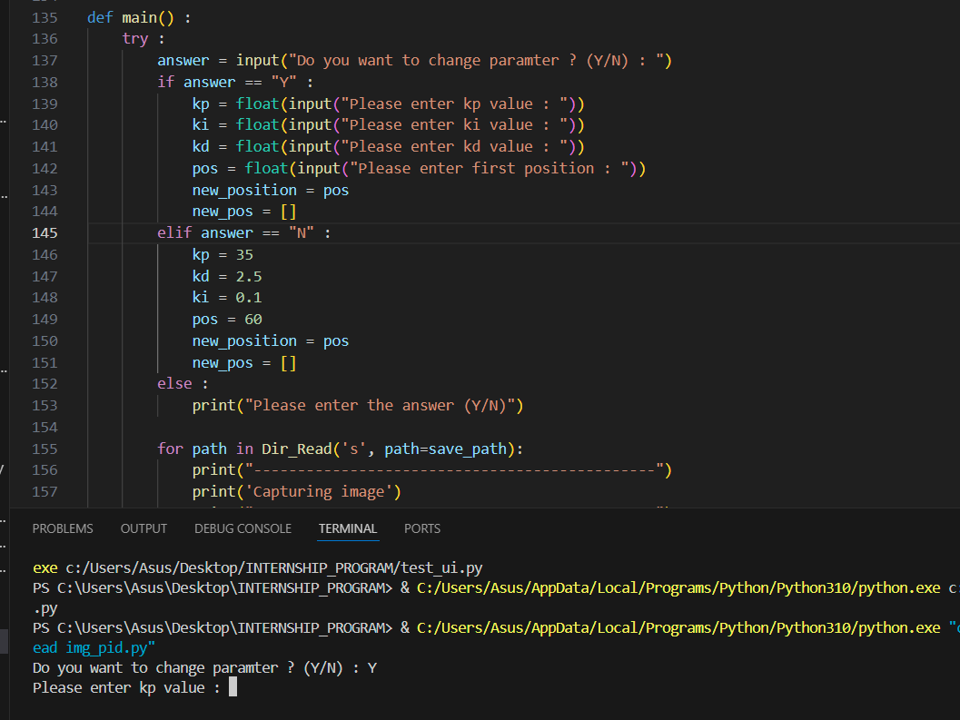
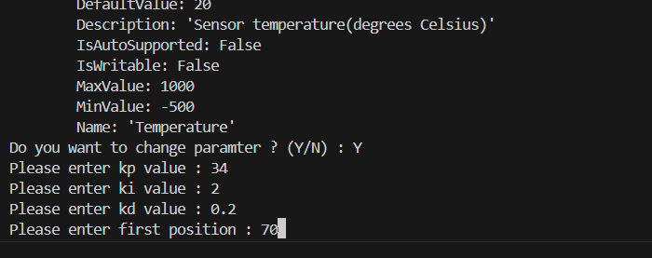
Additional
Add input command for users by command line.
35

Slide 38
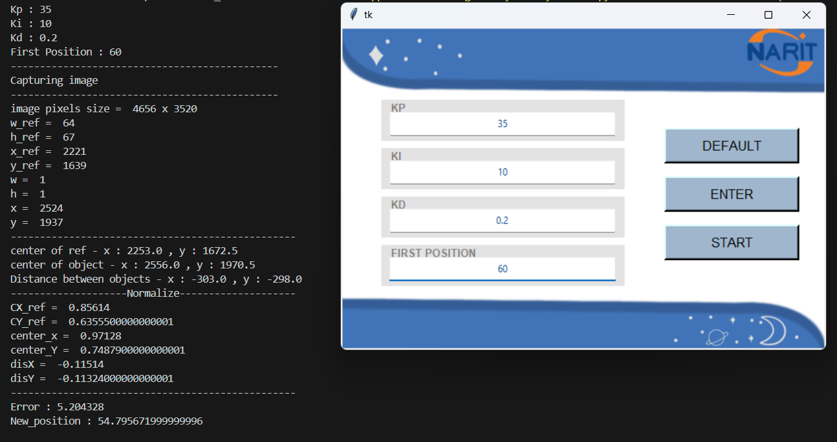
Additional
Add UI window for users .
36

Slide 39
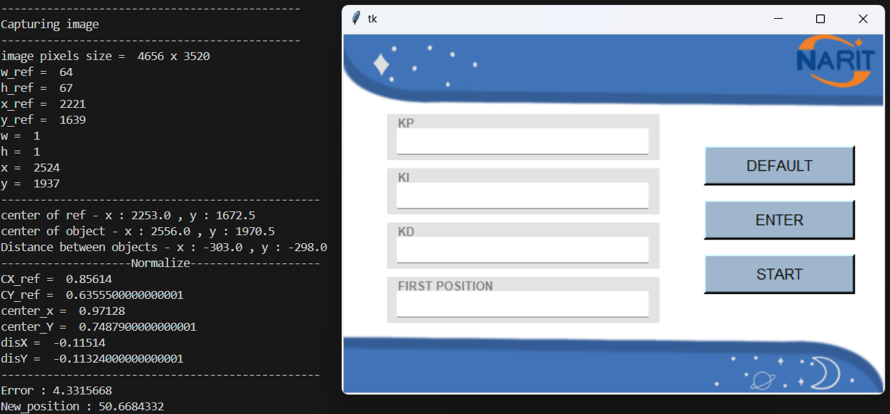
Additional
Have 2 options .
Option 1 : Enter values with default values.
Click “DEFAULT” button then program will start immediately .
37

Slide 40
Additional
Option 2 : Enter gain parameters with other values.
Enter value in each entry box then click “ENTER” button and click “START” for starting program.
38

Slide 41
05
Conclusion
39

Slide 42
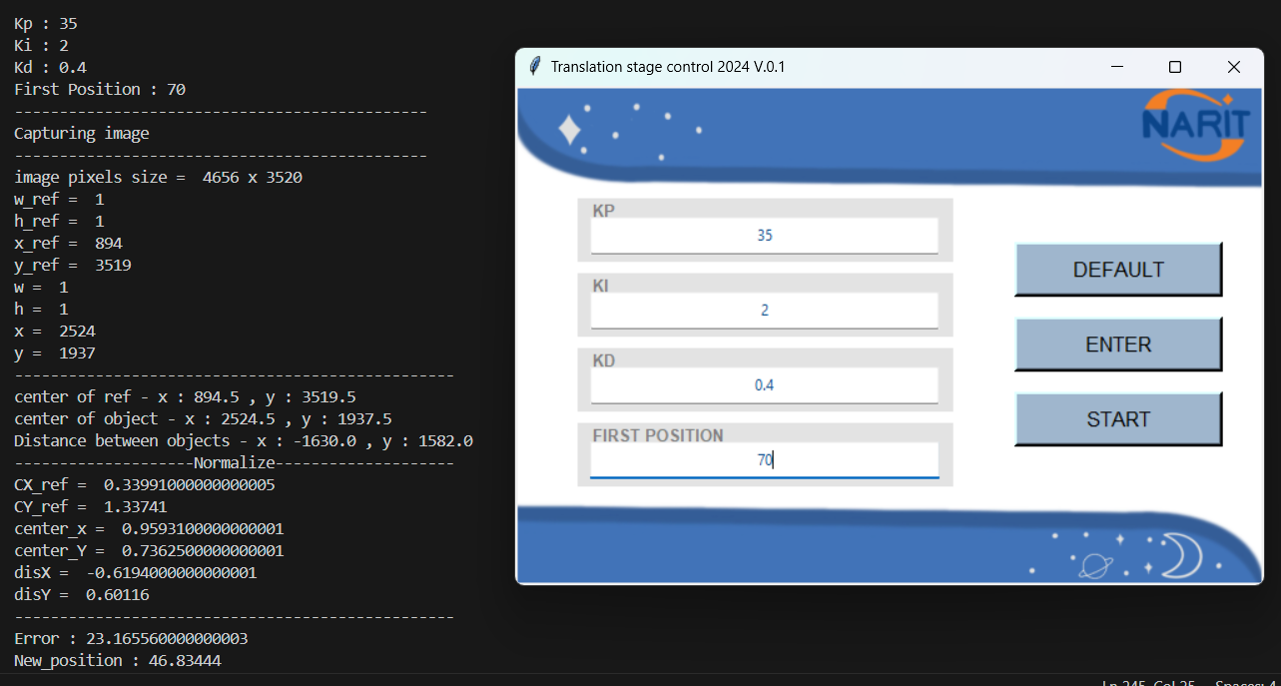
Both UI version and input command in terminal version work successfully.
Can control translation stage with PID closed loop control and collect images.
UI Version
Command line Version
40

Slide 43
Collected feedback from user (researcher)
Add the title of application
Display properly dynamic range of PID parameters
Create Stop and Home button
Initialize the PID parameters in entry boxes
Short describe for effect of each PID parameters
41

